Slide 1
DIGITAL PORTFOLIO
STUDENT NAME: NITHYA A
REGISTER NO / NMID: 4CBE76F30881B019C6542323682C1466
DEPARTMENT: B.Sc COMPUTER SCIENCE
COLLEGE: PERIYAR ARTS COLLEGE/ANNAMALAI UNIVERSITY

Slide 2
PROJECT TITLE
MY PORTFOLIO

Slide 3

AGENDA
Problem Statement
Project Overview
End Users
Tools and Technologies
Portfolio design and Layout
Features and Functionality
Results and Screenshots
Conclusion
Github Link
3/21/2024 Annual Review

Slide 4

PROBLEM STATEMENT
“ During a group project, our team struggled with poor communication and unclear task division, leading to delays. The problem was to create an efficient communication and task management system.”

Slide 5

PROJECT OVERVIEW
I am create an My portfolio using html,css,javascript.
This is very help to my creativity .

Slide 6

WHO ARE THE END USERS?
Teachers
Employers
Colleges
Teammates

Slide 7

TOOLS AND TECHNIQUES
Html
Css
Javascript

Slide 8
POTFOLIO DESIGN AND LAYOUT
About me
Skills
Project
Contact me
Simple and clean
Consistent
Header
Footer
8

Slide 9
FEATURES AND FUNCTIONALITY
1.Responsive Design:
The portfolio is designed to be responsive and works well on different
Devices and screen sizes.
2. Profect showcase:
A section to showcase projects with images,descriptions, and links.
3. Skills section:
A section to list technical skills and proficiencies.
4. Contact Form:
A contact form to allow visitors to send messages.
5. Smooth scrolling:
Smooth scrolling effect when navigating to different sections.

Slide 10
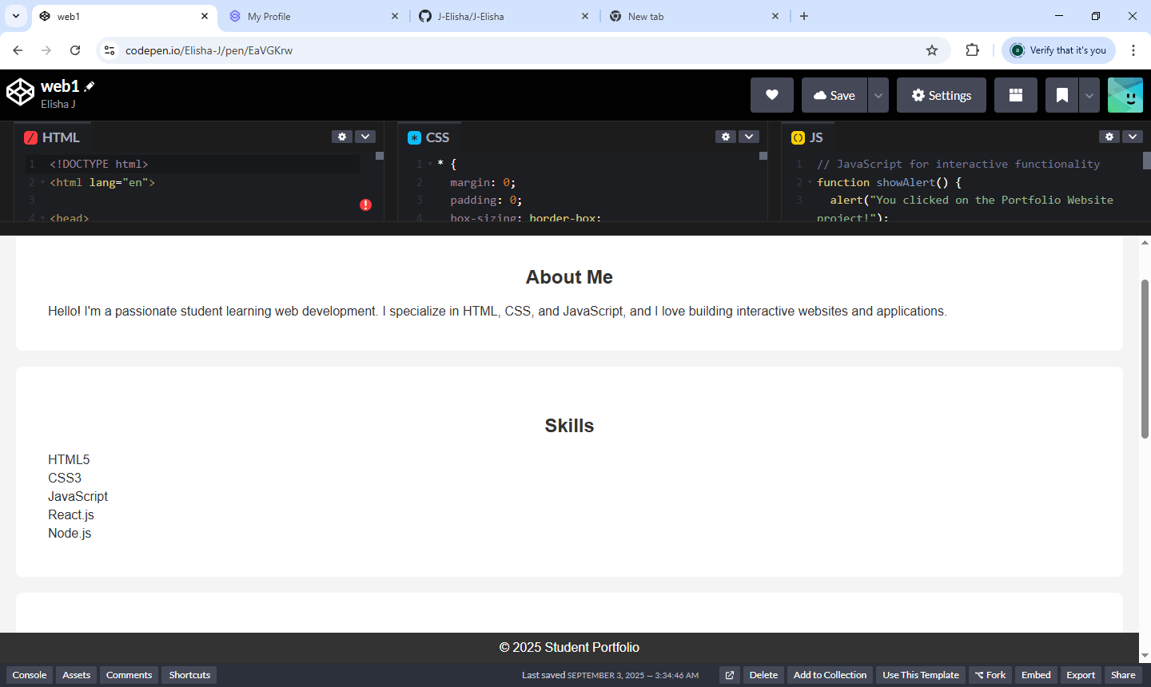

RESULTS AND SCREENSHOTS
3/21/2024 Annual Review
10

Slide 11
CONCLUSION
Thank you for exploring my portfolio!
I’m excited to showcase my projects,
Skills, and experiences as a student. Through this portfolio,I aim to demonstrate my growth,creativity, and passion for learning.
11

